Slide 1

March of the Penguins
PREPARED FOR:
YOU!
All materials and methodologies are copy written and protected Intellectual Property of Kate Burda & Company and for the express purpose for Luckey’s Management. Methodologies, systems, and constructs are not for external distribution and are protected.

Slide 2

VUCA WORLD
Volatility
Complexity
Uncertainty
Ambiguity

Slide 3
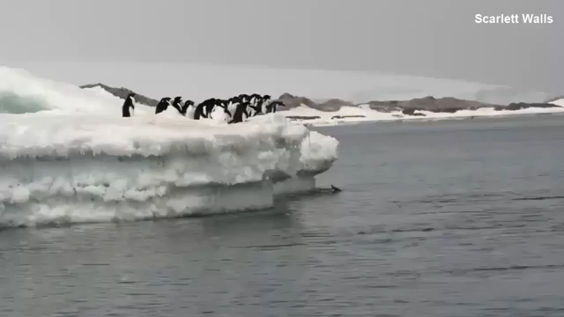

Slide 4
ADR Pricing Psychology in a Downturn

Slide 5
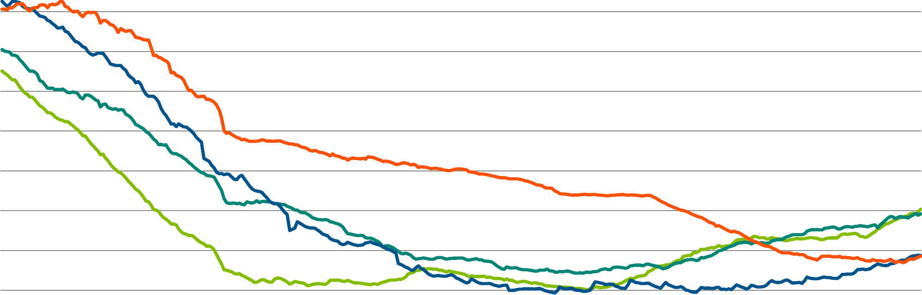
Sample Chicago Comp Set
0%
-2%
1
2
3
4
-4%
-6%
-8%
-10%
-12%
-14%
-16%
-18%
-20%
ADR % Decline
-30
-22
-14
-6
2
10
18
26
34
42
50
58
66
74
82
90
98
106
114
122
130
138
146
154
162
170
178
186
194
202
210
218
226
234
242
250
258
266
274
282
290
298
306
314
322
330
Days After Rogue Dropped 10%
© 2019 STR. All Rights Reserved.

Slide 6
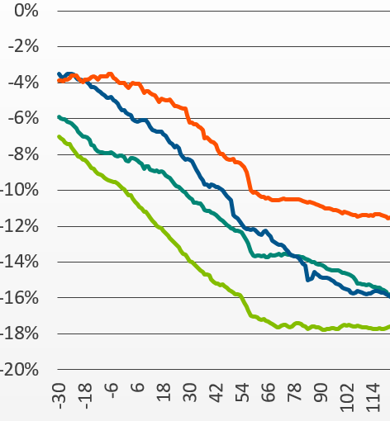
57 days
26 days
© 2019 STR. All Rights Reserved.

Slide 7
All Chicago Comp Sets
5%
0%
Rogue hotels and second movers
suffered ~20% Total ADR Drop
ADR % Decline
-5%
-10%
-15%
-20%
1
2
3
4
-25%
-30
-21
-12
-3
6
15
24
33
42
51
60
69
78
87
96
105
114
123
132
141
150
159
168
177
186
195
204
213
222
231
240
249
258
267
276
285
294
303
312
321
330
Days After Rogue Dropped 10%
© 2019 STR. All Rights Reserved.

Slide 8
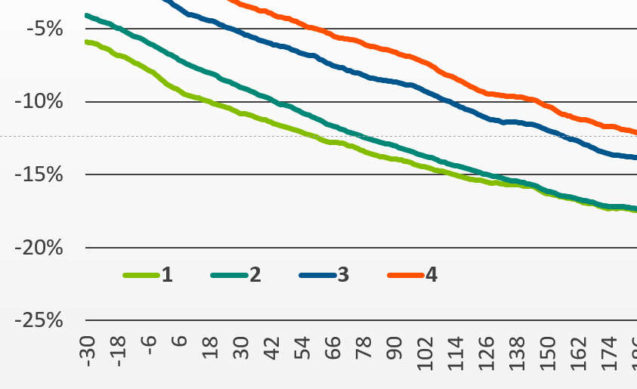
130 days
27 days
© 2019 STR. All Rights Reserved.

Slide 9
3rd and 4th Hotels Were Willing to Sustain Double the Occupancy Loss
1st 2nd 3rd
4th
-7.2%
-7.8%
-12.1%
-15.0%
-21.1%
-21.5%
-17.9%
-15.8%
Occ % Change At Peak RevPAR Drop
ADR % Change at Peak RevPAR Drop
© 2019 STR. All Rights Reserved.

Slide 10
Did any hotels not drop ADR?

Slide 11
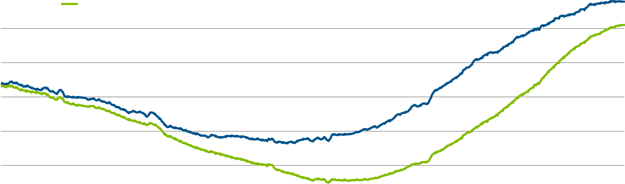
Hotels That Didn’t Slash ADR Lost More Demand…
15%
Hotels With ADR Drop >10%
10%
Hotels With ADR Drop <10%
Demand % Change
5%
0%
-5%
-10%
-15%
-20%
Sep 08
Dec 08
Mar 09
Jun 09
Sep 09
Dec 09
Mar 10
Jun 10
Sep 10
Dec 10
Source: STR
© 2019 STR. All Rights Reserved.

Slide 12
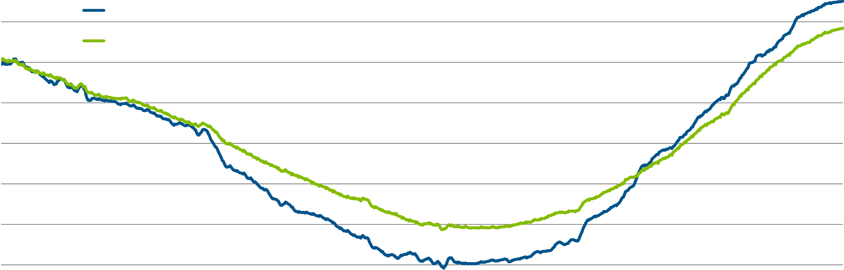
…But Experienced Less Extreme RevPAR Declines
10%
5%
Hotels With ADR Drop >10%
Hotels With ADR Drop <10%
RevPAR % Change
0%
-5%
-10%
-15%
-20%
-25%
-30%
Sep 08
Dec 08
Mar 09
Jun 09
Sep 09
Dec 09
Mar 10
Jun 10
Sep 10
Dec 10
Source: STR
© 2019 STR. All Rights Reserved.

Slide 13
Labor Costs and Profits in a Downturn

Slide 14













Demand, Revenue Declines led to Amplified Profit Declines in 2009
Demand
Rooms Revenue
Total Revenue
GOP
EBITDA
Total Labor Costs
-6.5
-9.0
-18.2
-17.4
-27.6
0.49x
RevPAR
-34.2
2009 U.S. Hotel Performance
1.5x
RevPAR
© 2019 STR. All Rights Reserved.

Slide 15












Similar Performance in 2001, although declines were less extreme
Demand
Rooms
Total Revenue
GOP
EBITDA
Total Labor Costs
-7.0
-5.2
-9.6
-9.3
-16.8
-16.5
0.54x
RevPAR
2001 U.S. Hotel Performance
1.75x
RevPAR
© 2019 STR. All Rights Reserved.

Slide 16
We have been preparing for this moment…
The Sales Team has been working on deeper and higher order business
….Because of that we should have a larger pipeline of business
Strategic Revenue Management Team

Slide 17
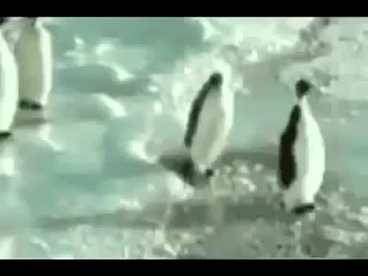

Slide 18


Slide 19
Readiness?
Having the right mind-set
Take a look at the top and target accounts at the hotel. Do we have deeper relationships beyond the travel or meeting planner?
Have a conversations looking at VUCA, exposure, and strategy within the power team of Operations - Sales – Revenue Management now

Slide 20

THANK YOU!

